Slide 1
Effect of Hand-movement on the Presence of another Person in a Virtual Environment
Felix Bühler, Jan Leusmann, Jamie Ullerich
Virtual and Augmented Reality | Stuttgart | 12.07.2019

Slide 2
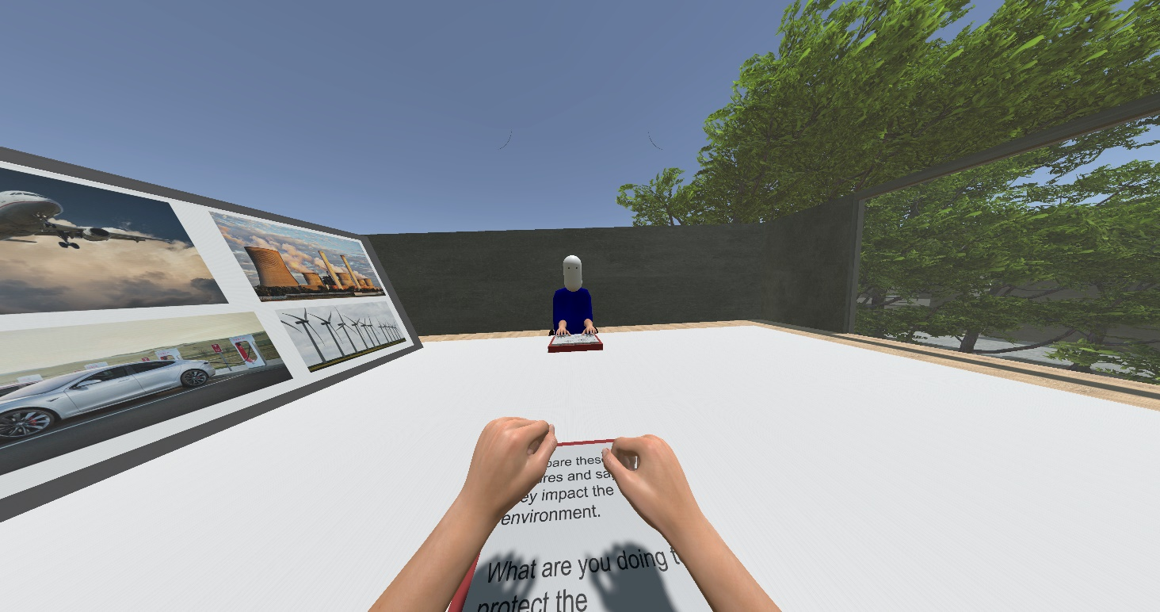
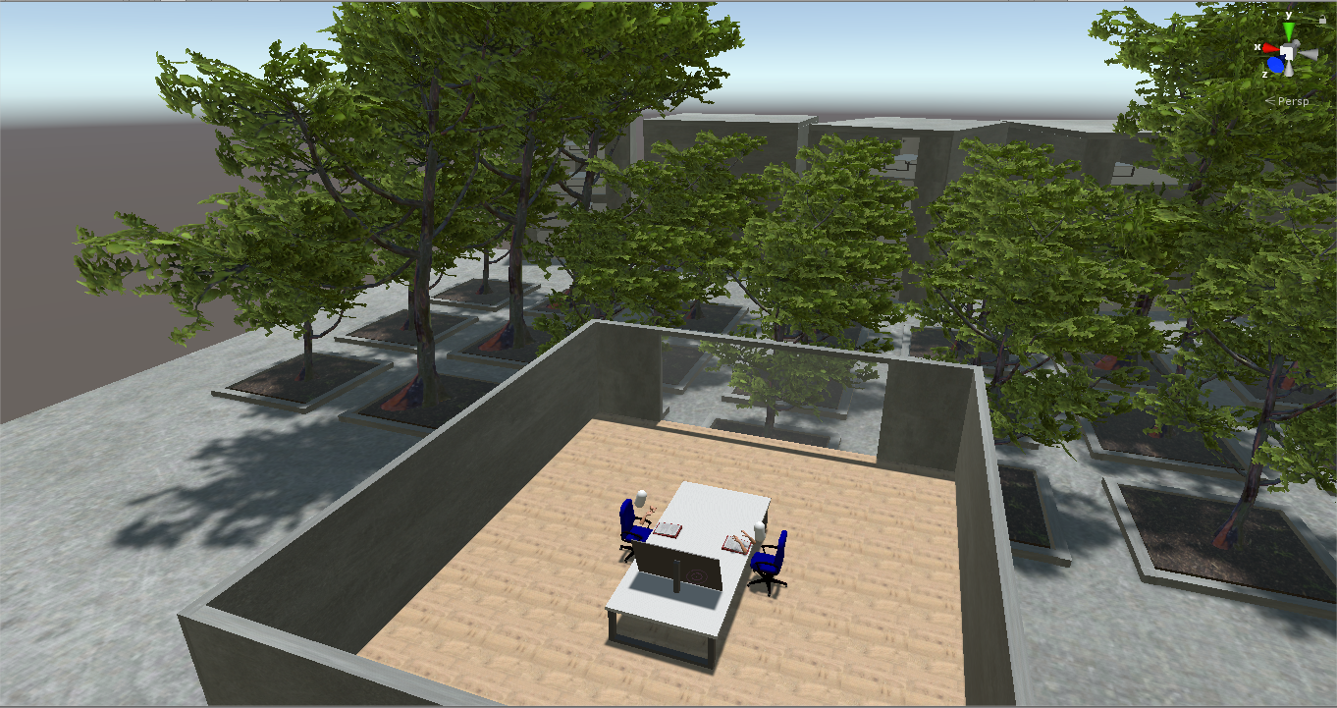
Study Setup

Slide 3
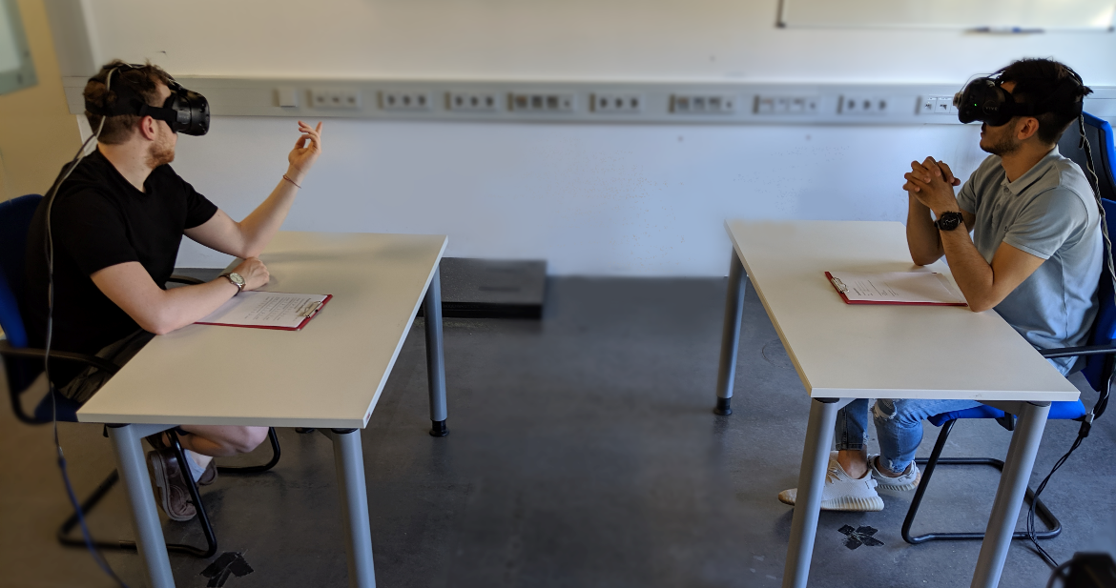
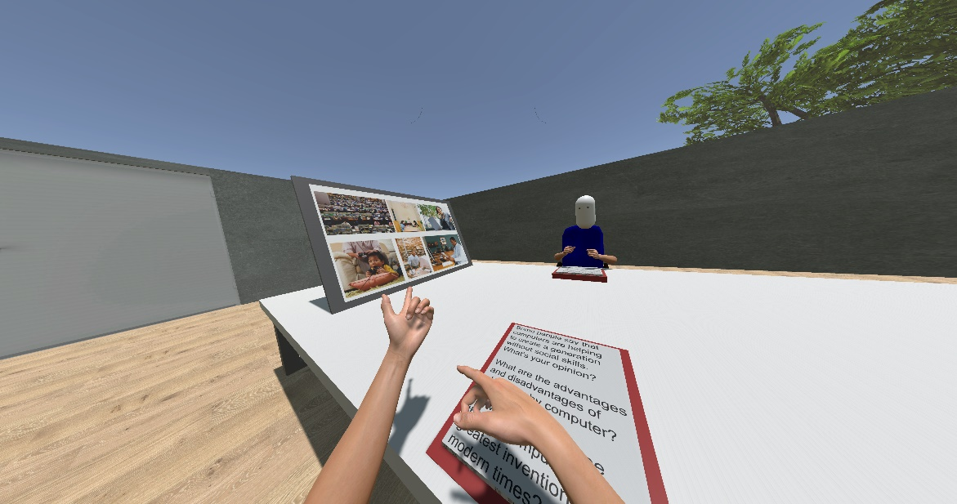
Study Setup
Notes:
12 participants
11 male, 1 female
23 – 28 years old (M = 24.5)
11: previous VR experience, 1 none

Slide 4
Procedure
Introduction
Study: Repeat for all 3 IV
Conclusion
Explanation / Consent Form
6 minute discussion
Semi-structured interview
Setup of the VR HMDs for both participants
Questionnaire
Notes:
klick for every box to appear (introduction, study, conclusion)
Procedure: told them to discuss topics → not tell them study about hand movement
3 sessions → 6 min discussion for each condition

Slide 5
Results – Qualitative
General feeling?
Most immersive condition?
Are gestures important?
Lot of hand movements?
Notice other person moving ?
Other person expressed himself though hand movement?
real > none > fake
Notes:
General feeling: most participants liked ability to move hands, but criticised technical implementations (transmission problems, hands disappearing)
which condition most immersive? real movement > no movement > fake movement
gestures important? yes
participant uses many gestures? 50% yes, 50% no/not really
notice other person moving? yes
expressed other person through movement? 33% yes, 33% not at all, 33% strange movements → now and then yes but mostly no

Slide 6
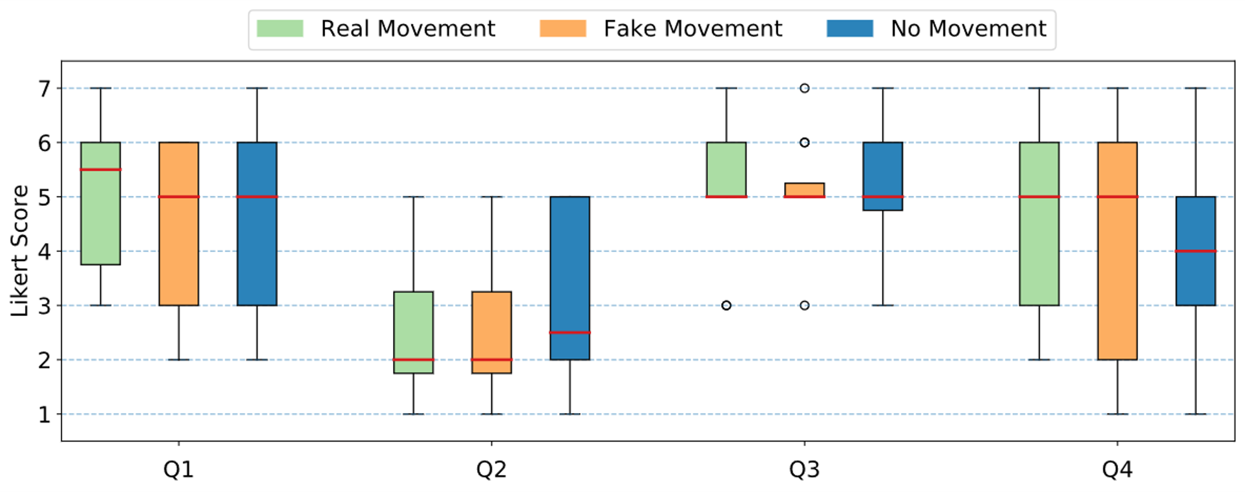
Results – Quantitative: Presence
I was not aware of my real environment
I still paid attention to the real environment
I had the sensation to feel present in the virtual space
It seemed like my own hands were located in the virtual world
Notes:
Q1 & I was not aware of my real environment
Q2 & I still paid attention to the real environment
Q3 & I had the sensation to feel present in the virtual space
Q4 & It seemed like my own hands were located in the virtual world
no significant differences

Slide 7
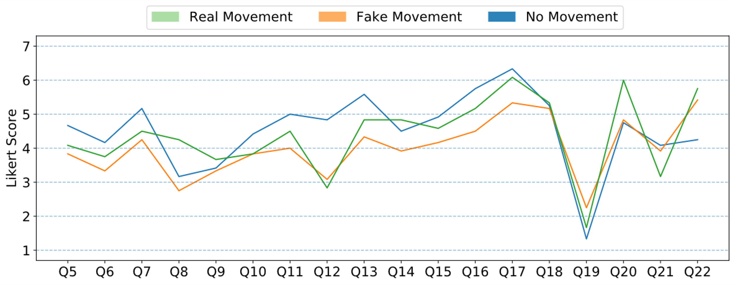
Results – Quantitative: Co-Presence
The other person's movement seemed hindered.
I felt alone in the virtual environment.
I had the impression that the person noticed me in the virtual space.
The person's behaviour had an influence on my mood.
I was able to interpret the person's reactions.
I was aware that other people were with me in the virtual room.
Notes:
significant questions: → klick to ausblenden not significant ones
klicken um jeweils die frage einzublenden → t-test ergebnis sagen und nächste frage
Q6: The person's behaviour had an influence on my mood. → t-test: no x real
Q12: I was able to interpret the person's reactions. → fake x real & no x real
Q16: I had the impression that the person noticed me in the virtual space. → no x real
Q17: I was aware that other people were with me in the virtual room. → no signif. diff.
Q19: I felt alone in the virtual environment. → no x real
Q22: The other person's movement seemed hindered. → fake x real

Slide 8
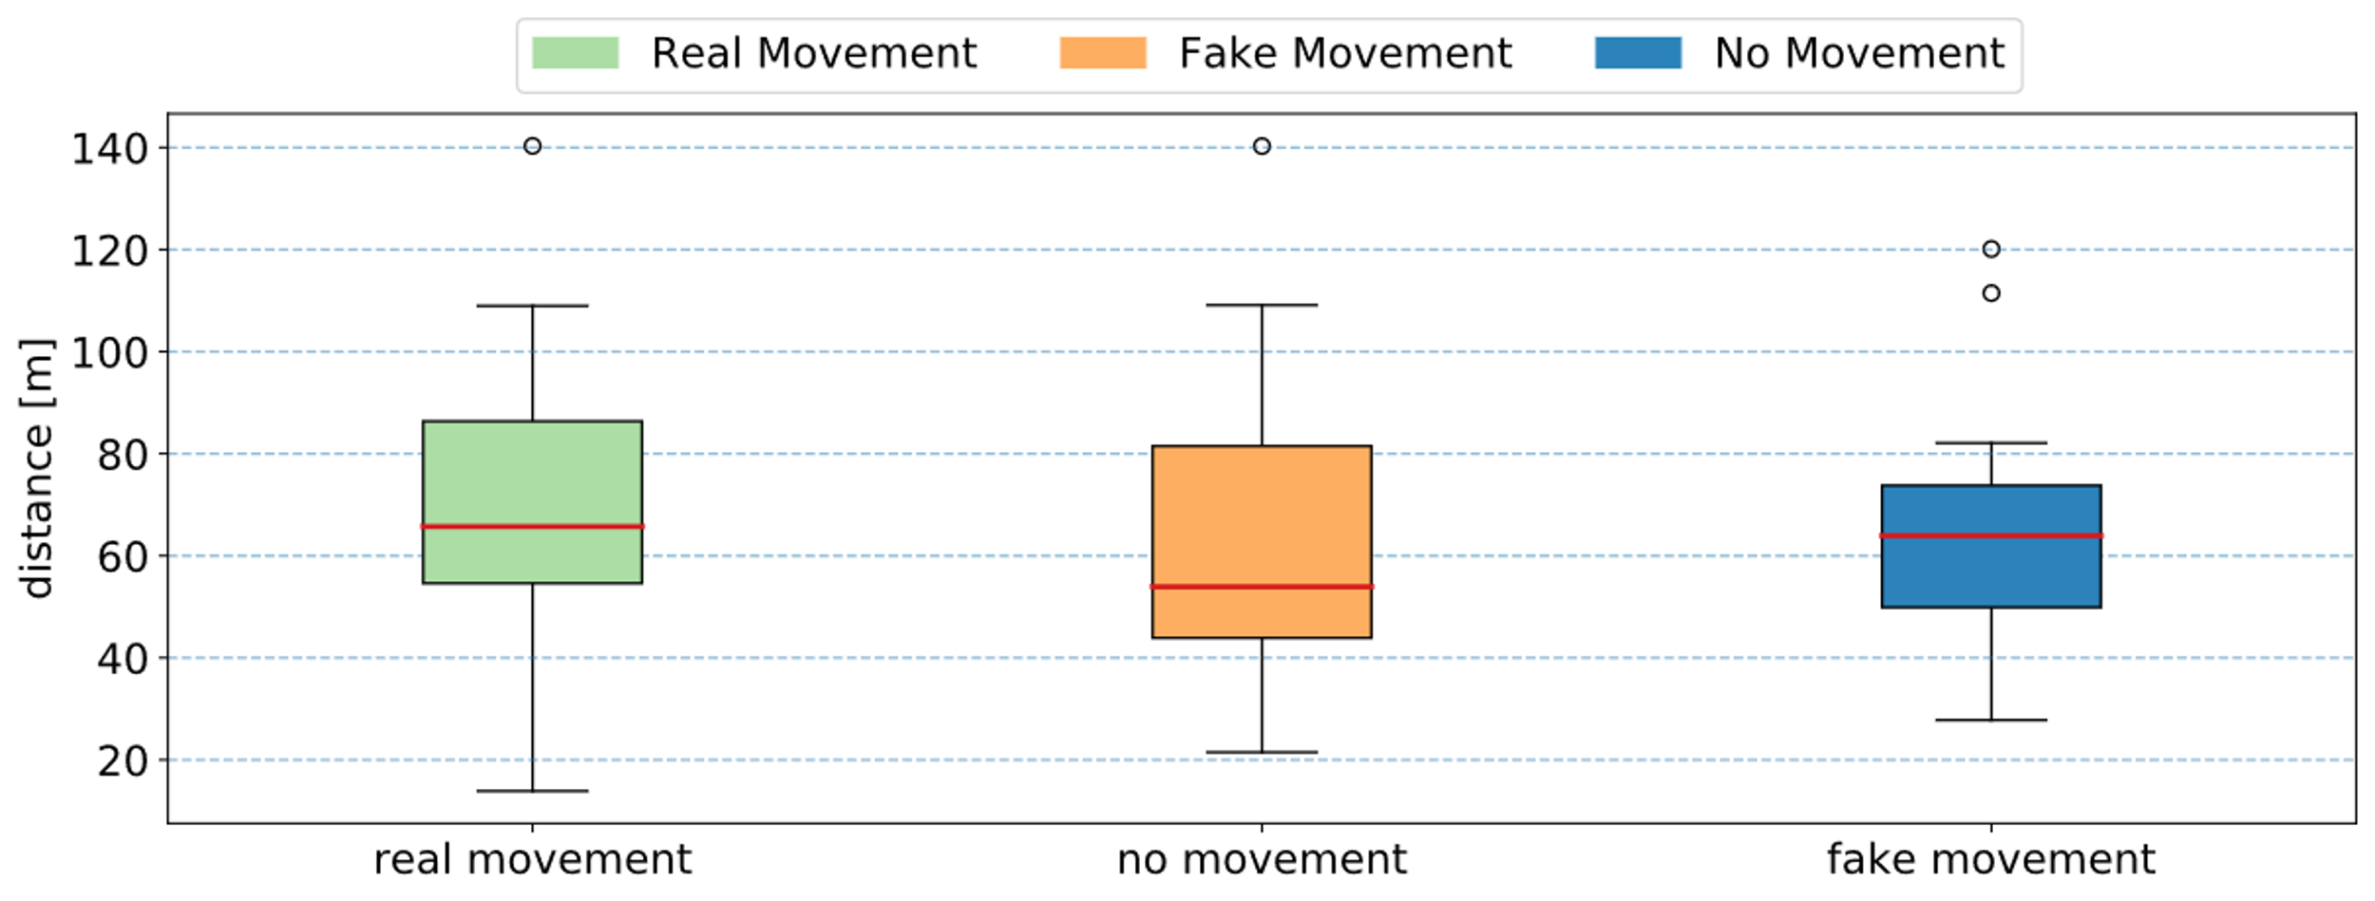
Results – Quantitative: Distance
Notes:
calculation: using Euclidean distance
→ no significant difference

